Slide 1
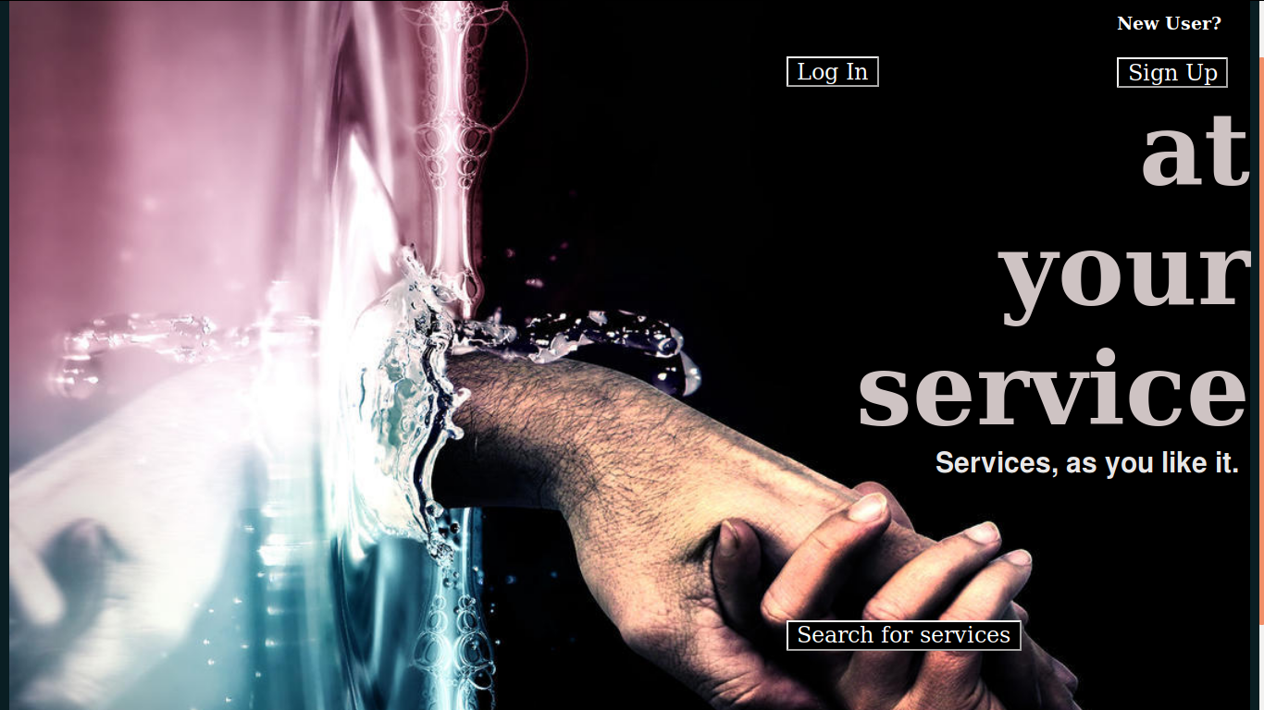
EVOLVE

Slide 2
FAILURE!

Slide 3

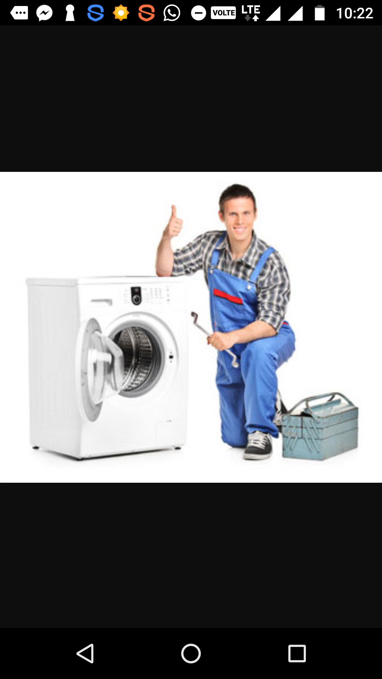



Our daily life problems…

Slide 4

ISQIP HACKATHON 2K17
Team EVOLVE presents…

Slide 5


At your service
Any help - the way you want

Slide 6
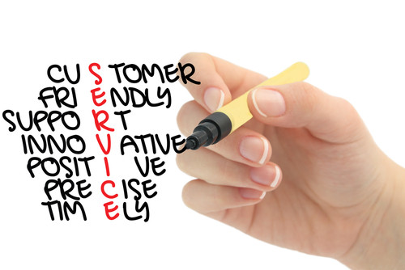

Slide 7


ABOUT
We provide the best matches for any service. We could match you up with people who could help you with the work. AYS has hundreds of service providers capable of doing a variety of jobs, both simple and hard. Your matched service providers provide you with the specific service you need and are available on all days including public holidays.

Slide 8
How it works
The people interested in helping others with their knowledge in fields like electrical, plumbing, electronics, machines, wiring, etc can sign up in our website. They are required to give their details including contact details, photograph, technical skills and preferred location.
Those who need the service has to visit the website and apply for it by filling a form. They have to mention their need, whether their need is an emergency or not and location.
The list of service providers are filtered according to the need and location entered and provides to the user the details of the service provider. The choice of selection of the provider is given to the user. Thus the website links these people according to their needs.
This website makes itself different from others by providing services faster and at a lower rate.

Slide 9

Advantages
It provides the user with an easier way to get their work done.
It acts as a connecting network that can connect different people with related needs.
Anyone can provide service
This way it helps 3 types of people:
People who need help
People who are employed and are still ready to help others at a lower rate
People who are in need of job

Slide 10

Future possibilities for this idea
We can make use of GPS services to compare the exact locations of the user and service provider for faster response.
This is availed for free lancers to meet up with people who might help them. The estimate can be quoted by the service provider (he/she may work for free or at a price).
Online and offline tutorial sessions can also be arranged for anybody.
The website can also provide a distress call button in case things went wrong or out of hands.
The services that we provide are too vast and the list goes on… B-)

Slide 11

Team EVOLVE
Thoufeek Hussain
Swetha Balram
Sourav Sunil
Namratha Jacob

